Slide 1




GMS Webinar Series
Stephanie
Swaim
Michaela
Weis-Heidemann
Hanna Luise
Hilsdorf
Use DiaMIND to identify your product benefits
and compete successfully in your market!

Slide 2
AGENDA for the next 30 minutes
1
Day-to-day business situations that require reliable comparisons
of product characteristics
2
Show superiority for your product compared to competition
3
Check market for products that meet specific criteria
4
DiaMIND Demo
5
Questions & Answers

Slide 3


Day-to-day business situations that requore reliable comparisons of product characteristics
Two possible
situations
Situation 1
You would like to show superiority for your product in comparison to competitive products
Situation 2
You would like to check
the market for
products that meet
specific criteria

Slide 4
Situation 1:
You would like to show superiority for your product in comparison to competitive products
Sales Rep: „Customers are asking me what makes our product better
than competing products they are familiar with and recommend to patients.
>> How can I answer?”
?
„Is there a tool that can help?“
!
Yes - DiaMIND is your resource to compare your products with the competition.

Slide 5

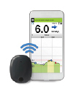
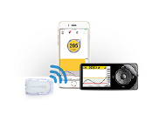
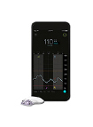
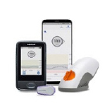
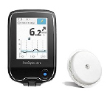
A concrete example
Profiling the Eversense XL sensor
Example –
How to profile the Eversense XL sensor
versus competition:
Dexcom G5
Dexcom G6
Guardian Connect
FreeStyle Libre

Slide 6
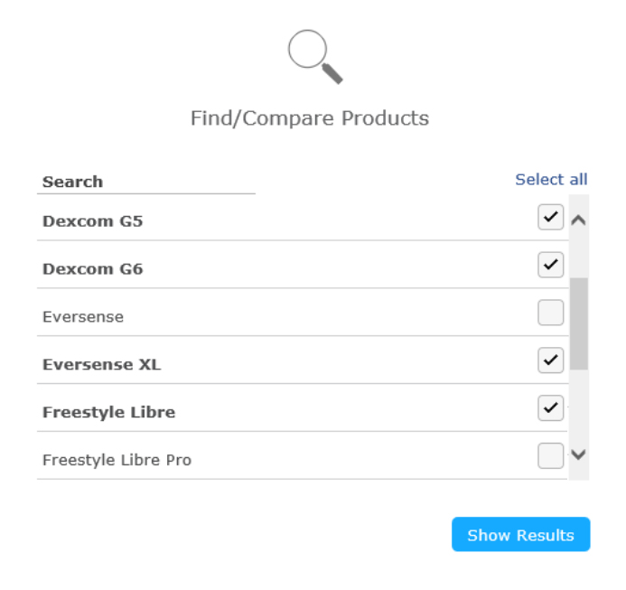
Solution – Step 1:
Check for product information in DiaMIND
[Live demo:
https://roche.sharepoint.com/sites/DiaMIND/SitePages/DiaMIND.aspx ]

Slide 7
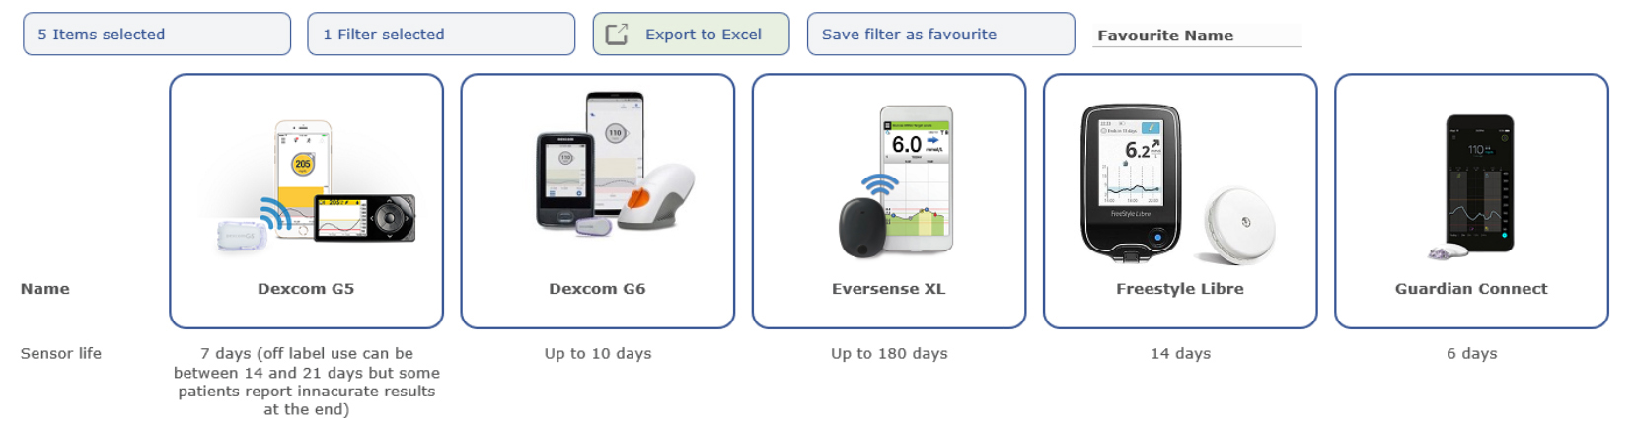
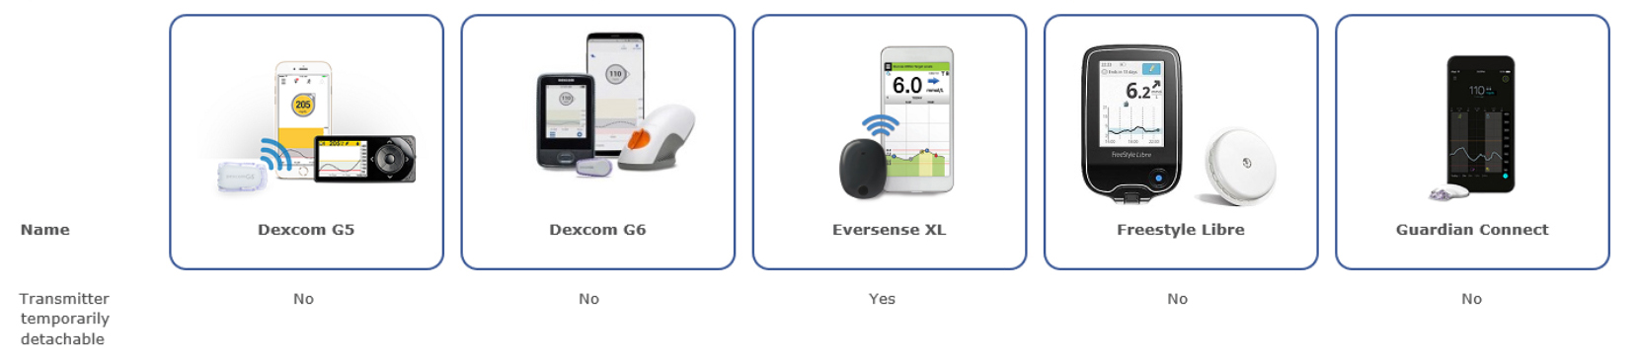
Solution – Step 2:
Identify strengths of the RDC product
(e.g. sensor lifetime, temporarily detacheable sensor)

Slide 8
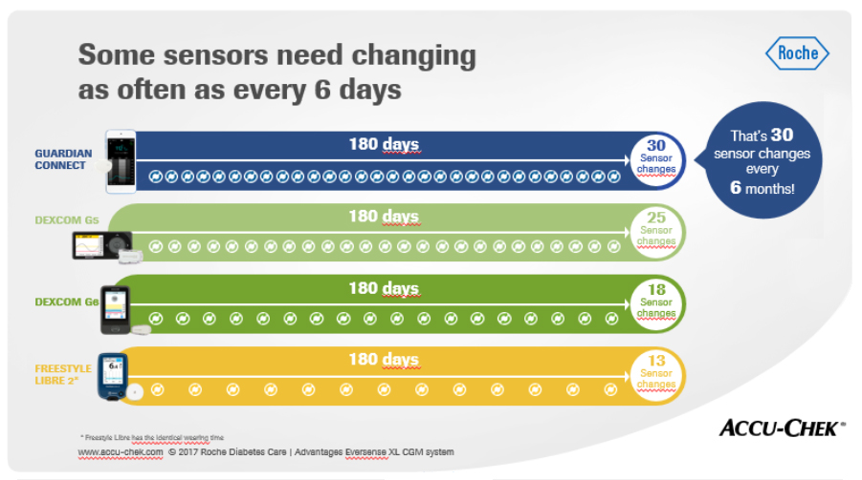
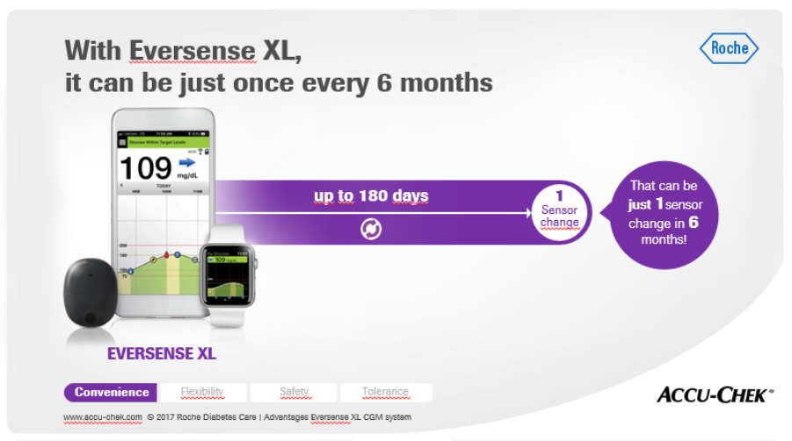
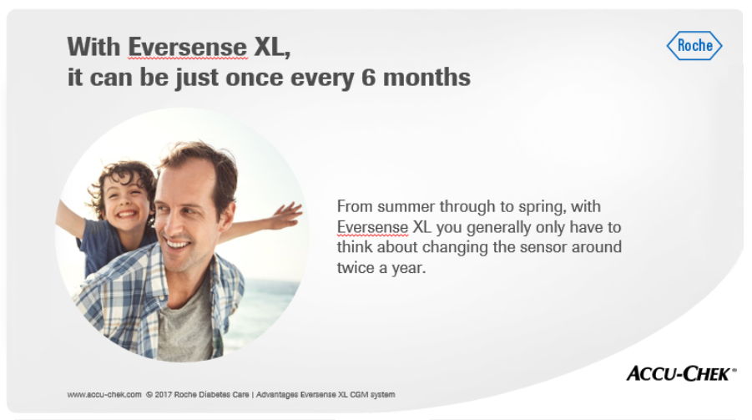
Solution – Step 3:
Turn strengths into benefits (e.g. sensor lifetime)

Slide 9
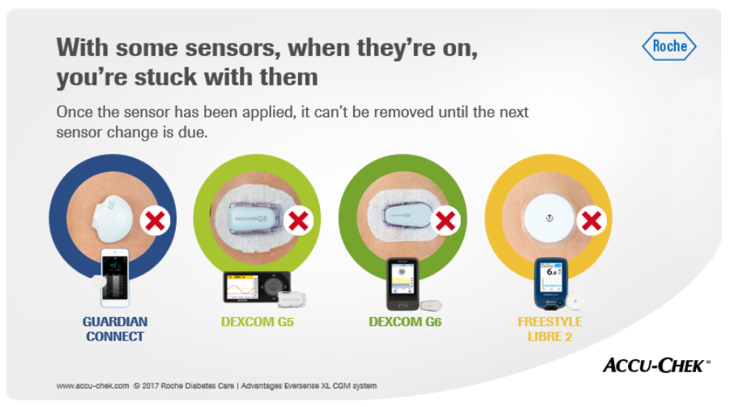
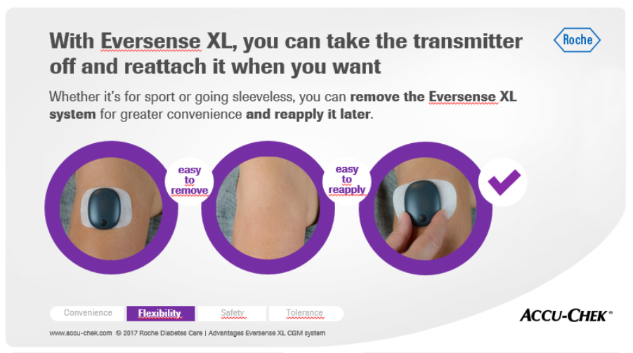
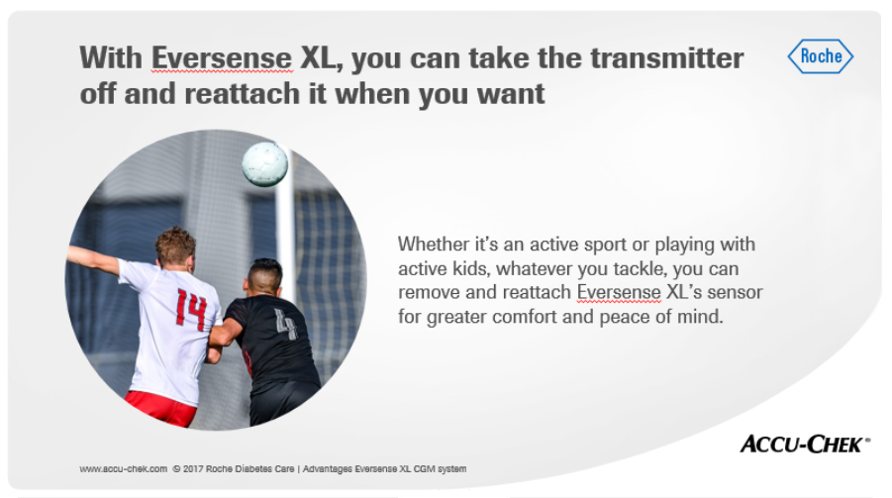
Solution – Step 3:
Highlight the strengths (e.g. on-body vibration alarms)

Slide 10

Solution – Step 3:
Highlight the strengths

Slide 11
Situation 2:
Check the market for products that meet specific criteria
An upcoming tender is expected.
Tendering criteria are published.
Which competing products meet the specified criteria?
?
„Is there a tool that can help?“
!
Yes! DiaMIND – THE tool for comparing your
products with the competition.

Slide 12

A concrete example
Check the market for products that meet specific criteria
Example –
Tender criteria for a BGM meter:
Required blood volume: 0.5 µL or less
Measuring time: 5 seconds
Hematocrit range: 15 – 60%
Test strip ejector

Slide 13
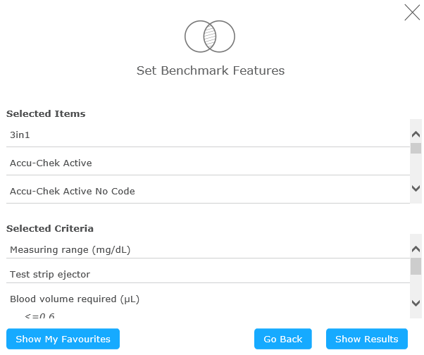
Solution – Step 1:
Check for information on tender criteria in DiaMIND
[Live demo:
https://roche.sharepoint.com/sites/DiaMIND/SitePages/DiaMIND.aspx ]

Slide 14
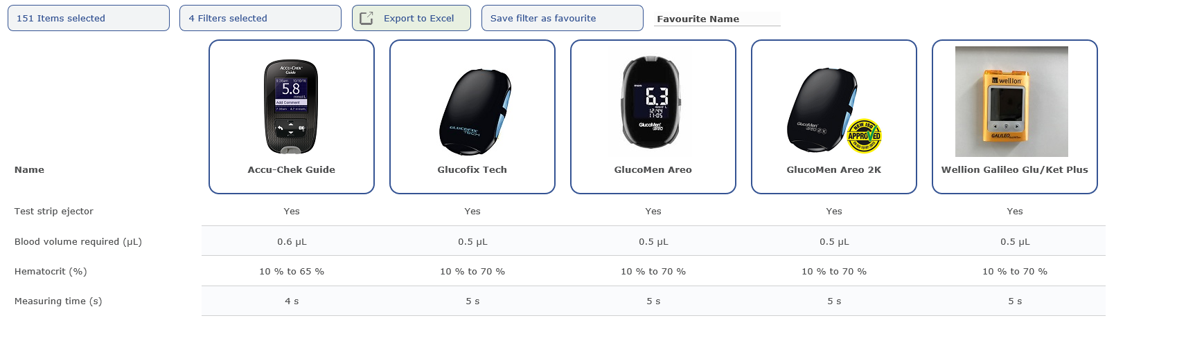
Solution – Step 2:
Identify relevant competitors

Slide 15
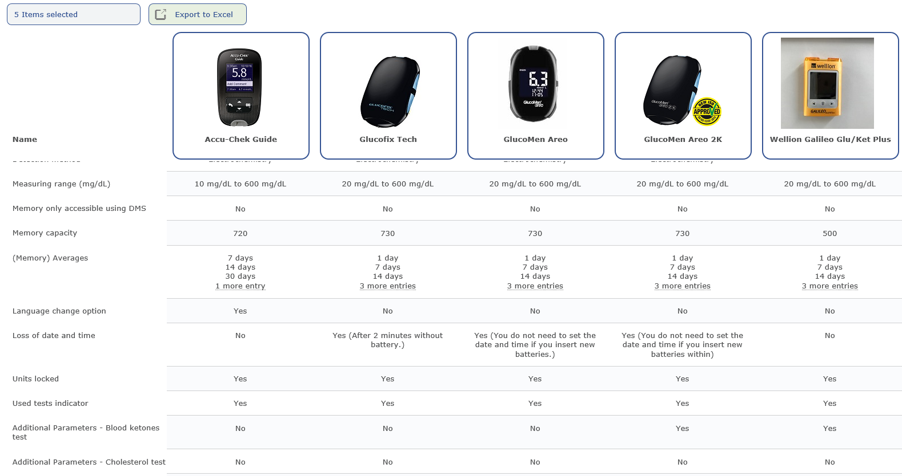
Solution – Step 3:
Learn more about your competitors

Slide 16

SUMMARY
!
DiaMIND – THE tool for comparing all your products
with the competition
BGM
Lancing devices
CGM/FGM
Smart pens
Pen needles
Insulin pumps
Infusion sets
Apps and
Software

Slide 17
SUMMARY
!
DiaMIND – THE tool for comparing all your products
with the competition
for
… evaluating product characteristics
… identifying strengths (and weaknesses)
… building a story on the findings
!
Plus:
- information about recalls and performance publications
- „save favorite“ feature
- „export to Excel“ feature

Slide 18
THANK YOU FOR YOUR ATTENTION.
Comparing product characteristics specifically with
DiaMIND can maximize your competitive edge!

